Slide 1
Predict a policy type and price for a customer based on browsing and transaction history INFO 7309 Machine Learning for Business Intelligence
Data Wizards
Leela Gangadhar Vallabhaneni
Nuhiya Rafeeq
Sumit Deshmukh

Slide 2
Project Understanding:
Car insurance
Target: predict policy and price
Cost of a product is a function of both the product options and customer characteristics.
A customer may purchase a product that was not viewed.

Slide 3
Approach
Approach 1: Non-hypothesis driven data analysis (i.e. Boiling the ocean)
A lot of data
Time wasted analyzing and understanding every available variable
Do not know what you are looking for
Explore every possible variable and relationship in hope to use all
Approach 2: Hypothesis driven analysis
List down comprehensive analysis
See if they are available.

Slide 4
Hypothesis Generation
What?
Hypothesis is a possible view about the problem
May be true or may not be true
Why?
Building features which are not biased by the data available in the data-set.
Could be better or not.

Slide 5
Hypothesis
Does cost depend on policy?
Does the financial status depend on the policy purchased?
Do customers with a risky profile tend to buy a certain kind of policy?
Does the state matter?

Slide 6
Data Understanding
Different Types of Attributes
Categorical | Ordinal | Numerical
State | Policy | Group Size
Location | Risk Factor | Homeowner
Married Couple | Age_Oldest | Car Age
Car Value | Age_Youngest | Duration_Previous
Day | C_Previous | Cost
 | Time

Slide 7
Data Understanding
Does State plays an important role?
Did the Customer change C_previous in later sessions?
When did he change the C_previous, at which shopping point?
How much did cost changed due to the change in C_previous
Did he view the policy that he purchased?
If the browsing sessions could be combined into one session per customer, would this help generate a new attribute?

Slide 8
Data Preparation
Different Types of attributes.
Duplicates.
Missing Values, NA values, Outliers.
Different ranges of attributes.
Unbalanced classes.

Slide 9
Data Preparation
Day: Weekend, weekday
Age_oldest and age_youngest: Binary
Time 4 categories ( 7 AM, 12 PM, 5 PM, 9 PM)
Car_age 3 categories: (low, medium, high)

Slide 10
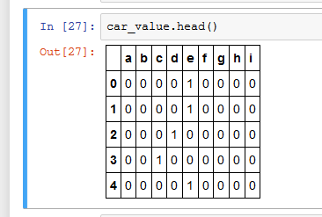
What to do with Categorical Variables?
Since they do not have any particular order, they cannot be treated as numeric variables.
Ex: Day, State, Location, Car_Value, etc
Solution:
One hot encoding/ 1-of-n encoding

Slide 11
Data Preparation for session History
NA values revealed at a later point (c_prev and duration_prev)
This was used to fill NA values for that customer.
Remaining NA values : Median/MICE
Feature generation:
Did he change the C_prev?
At which shopping pt?
Time difference between 1st and last session in hours.

Slide 12
Missing Values
Risk Factor: MICE
Multivariate Imputation by Chained Equations
Imputes missing values with plausible data values.
Why? –Risk Factor depends on customer characteristics.
C_Pervious and Duration_Previous
Median values.
Why? –Independent variables, do not depend on other characteristics in the dataset.
Car Value in train.csv
Median

Slide 13
Normalization
What?
Adjusting values measured on different scales to a common scale, in this case a Normal Distribution.
When?
Various attributes having various ranges
Why?
This can guarantee stable convergence of weight and biases.
How?
standard score (Z-score)
(a) allows to calculate the probability of a score occurring within our normal distribution
(b) enables comparison of two scores that are from different normal distributions

Slide 14
Cross Validation
What?
Also called Rotation Estimation
A method of assessing the accuracy and validity of a statistical model.
Achieve more generalized relationships.
10 fold Cross Validation
Did not yield significantly better results.

Slide 15
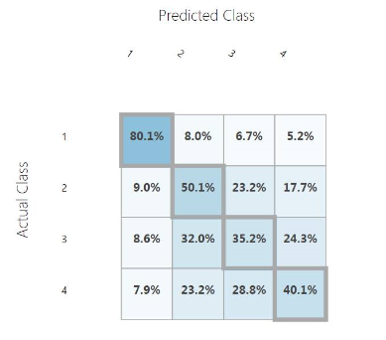
Under Sampling
Use fewer samples of highly represented classes.
Decision Forest
Accuracy: 75.74%
Result: Decreased Accuracy.

Slide 16
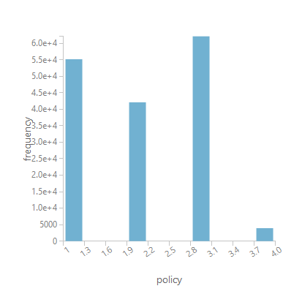
SMOTE
Synthetic Minority Over-sampling Technique
Used for over sampling data
Synthetic data is introduced for low represented classes
Azure ML SMOTE
Policy No-2 better.
Policy No-4, still poor.

Slide 17
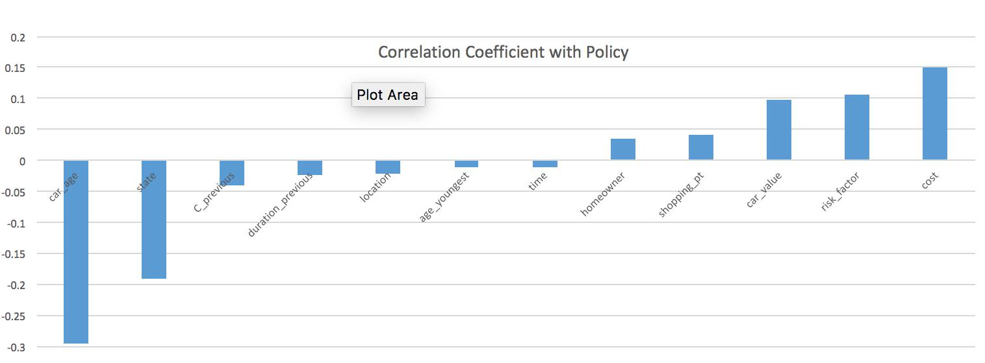
Feature selection
Pearson Correlation Coefficient

Slide 18
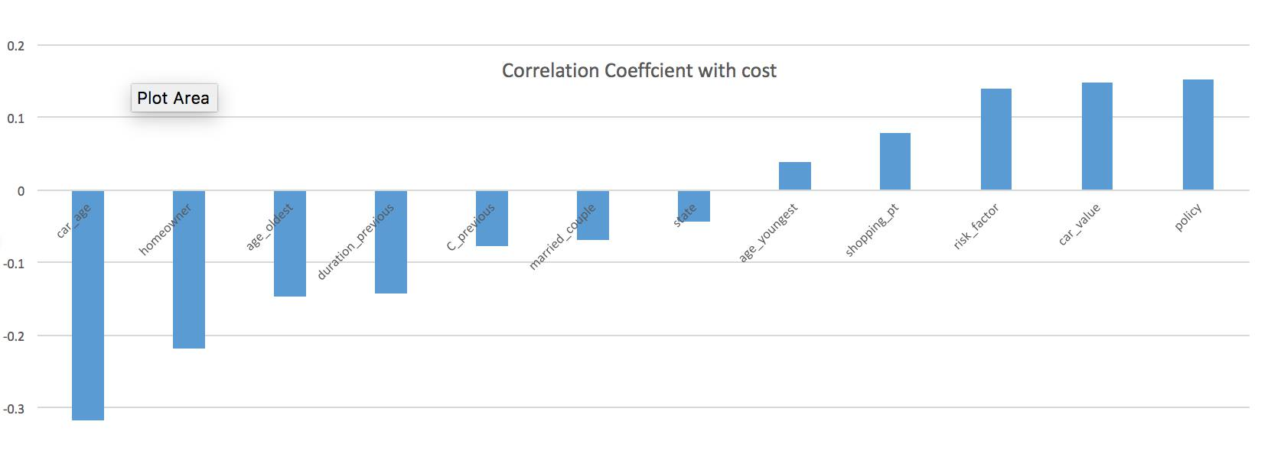
Feature selection
Pearson Correlation Coefficient

Slide 19
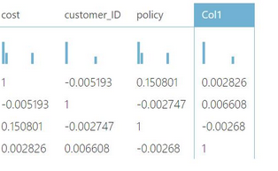
PCA
Feature reduction
Variables not closely correlated.
PCA on:
Married couple
age_youngest
age_oldest
shopping_point
group_size
duration_previous.

Slide 20
Modeling
Classification:
(Azure)
Multiclass Decision Forest
Multiclass Decision Jungle
(Python)
KNN
Naïve Bayes

Slide 21
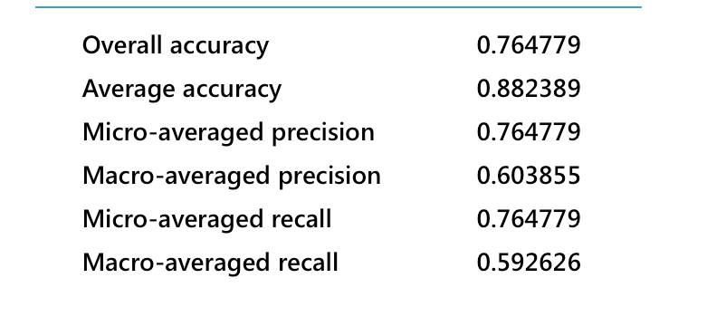
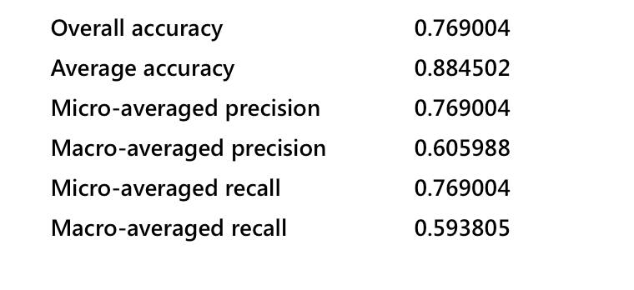
Results on Validation and Test
Decision Forest Classifier
Validation Dataset
Test Dataset

Slide 22
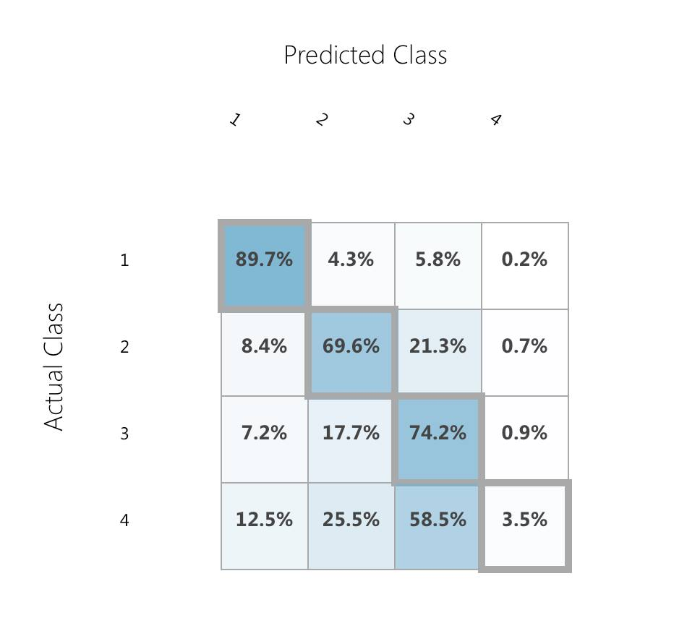
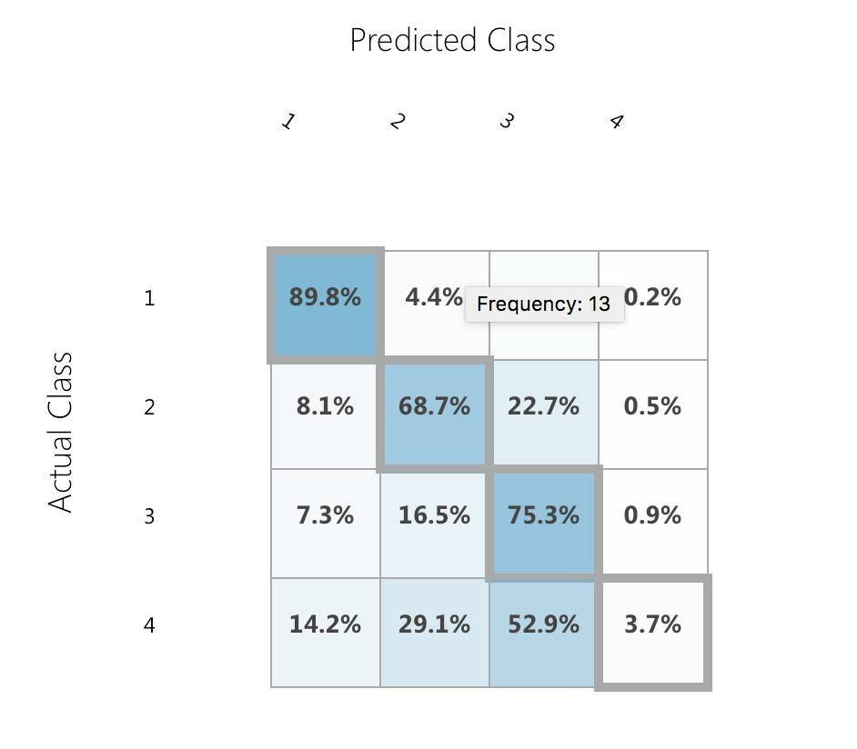
Results on Validation and Test
Validation Dataset
Test Dataset

Slide 23
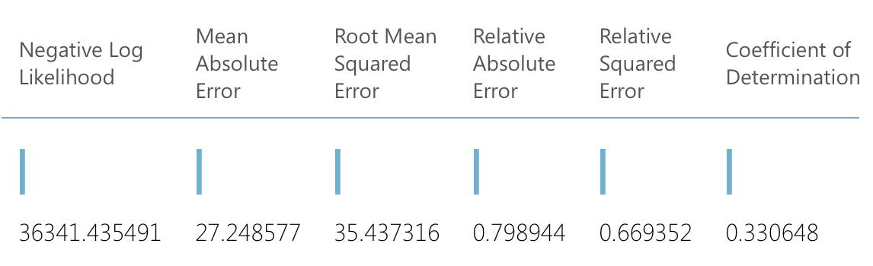
Linear Regression
Decision Forest Regression

Slide 24
Thank You.

